Slide 1
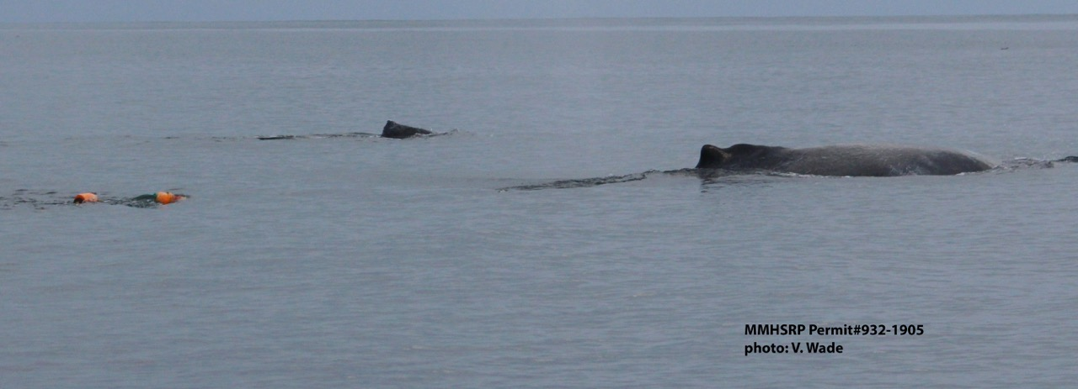
1. 20150217Mn – Humpback

Slide 2
1. 20150217Mn
Fishery: Recreational Dungeness crab gear
Gear set on 2/11; entanglement occurred sometime between 2/11-15th; entanglement reported 2/17
  found while looking for 2/16 humpback entanglement report
Report location: Moss Landing
Reported as: 2-3 orange buoys trailing approx. 10 ft behind whale; possible mouth/pec entanglement
From gear owner: 1 crab pot set on 300 ft of line in 173 ft of water in Moss Landing

Slide 3
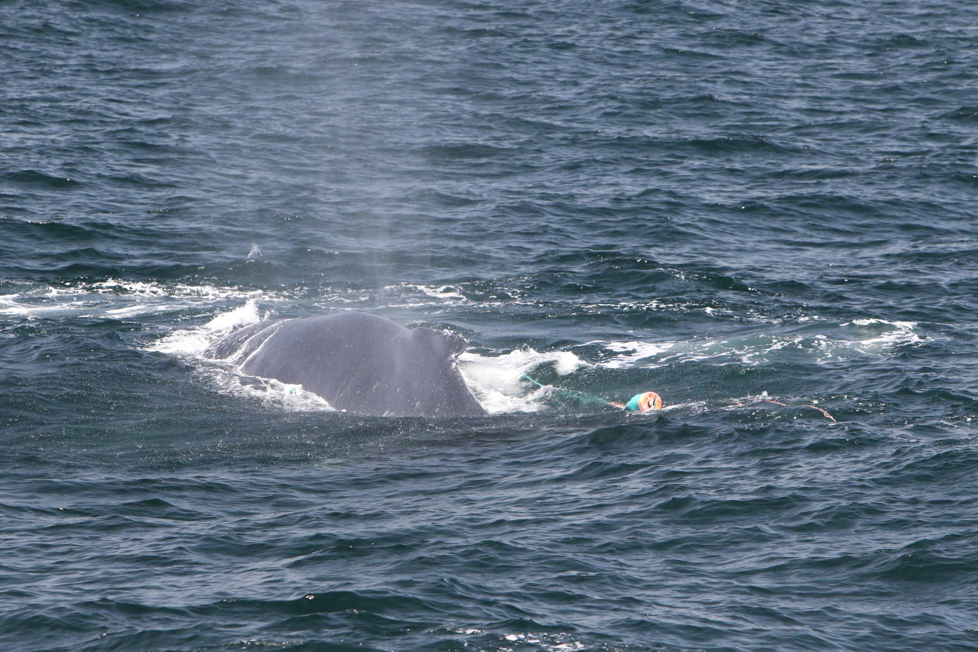
2. 20150516Mn - Humpback
NOAA MMHSRP Permit #: 18786

Slide 4
2. 20150516Mn
Fishery: California commercial Dungeness crab
Line coming down both sides of body from the head; one small white bullet buoy and larger turquoise green/orange buoy
Reported 5/16 in Santa Barbara
From gear owner: gear set Pt Buchon - Piedras Blancas in about 60-70 fathom
Whale traveled approximately 150 nm

Slide 5
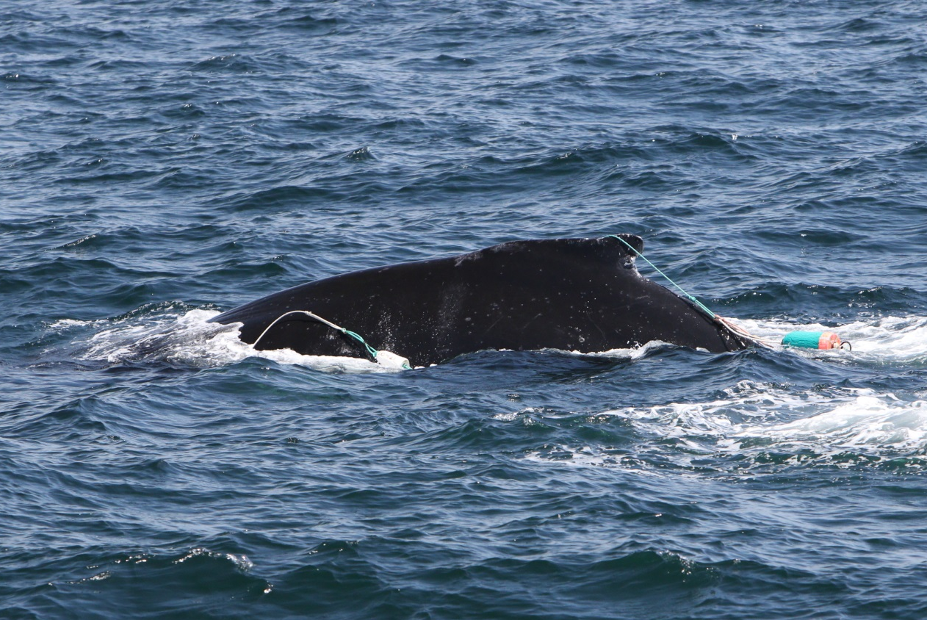
2. 20150516Mn - Humpback
NOAA MMHSRP Permit #: 18786

Slide 6
2. 20150516Mn
NOAA MMHSRP Permit #: 18786

Slide 7
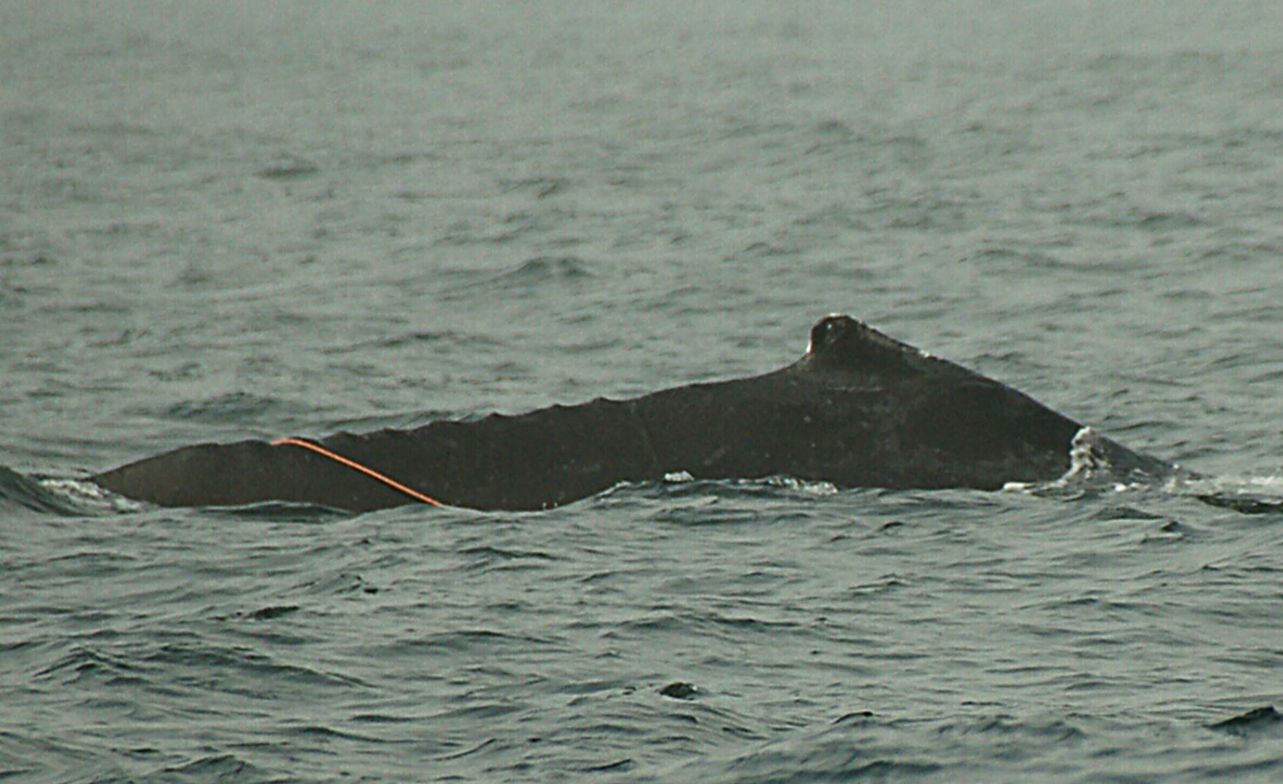
3. 20150625Mn - Humpback
NOAA MMHSRP Permit #: 18786

Slide 8
3. 20150625Mn
Fishery: California commercial Dungeness crab
Reported in Monterey
From gear owner: set gear in April just outside of the Santa Cruz MPA, set gear in 40 fathoms with 15 fathoms of scope, line was 2 x 20 fathoms shots of line with leads every 40 ft, 18 ft of line to trailer buoy

Slide 9
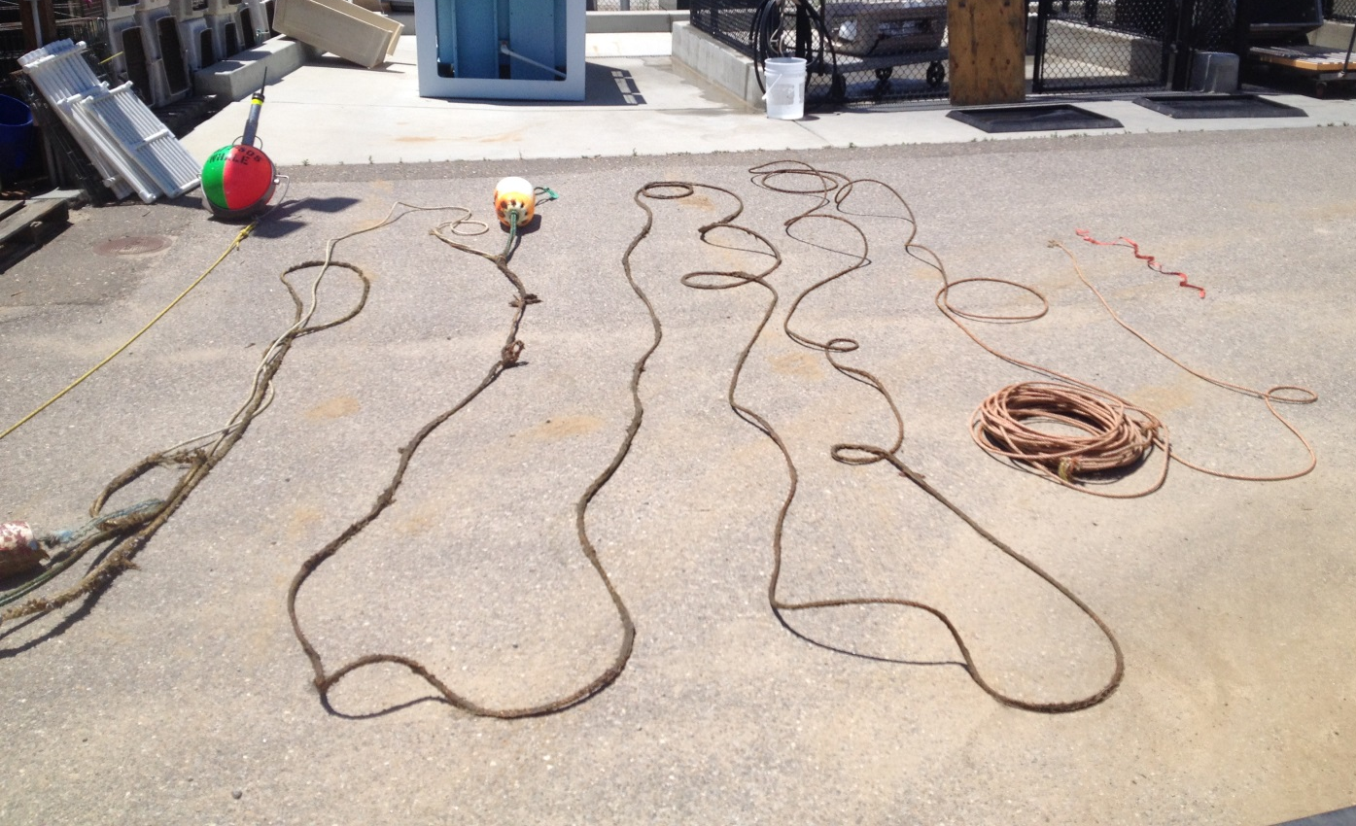
3. 20150625Mn Recovered Gear
NOAA satellite telemetry buoy
NOAA MMHSRP Permit #: 18786

Slide 10
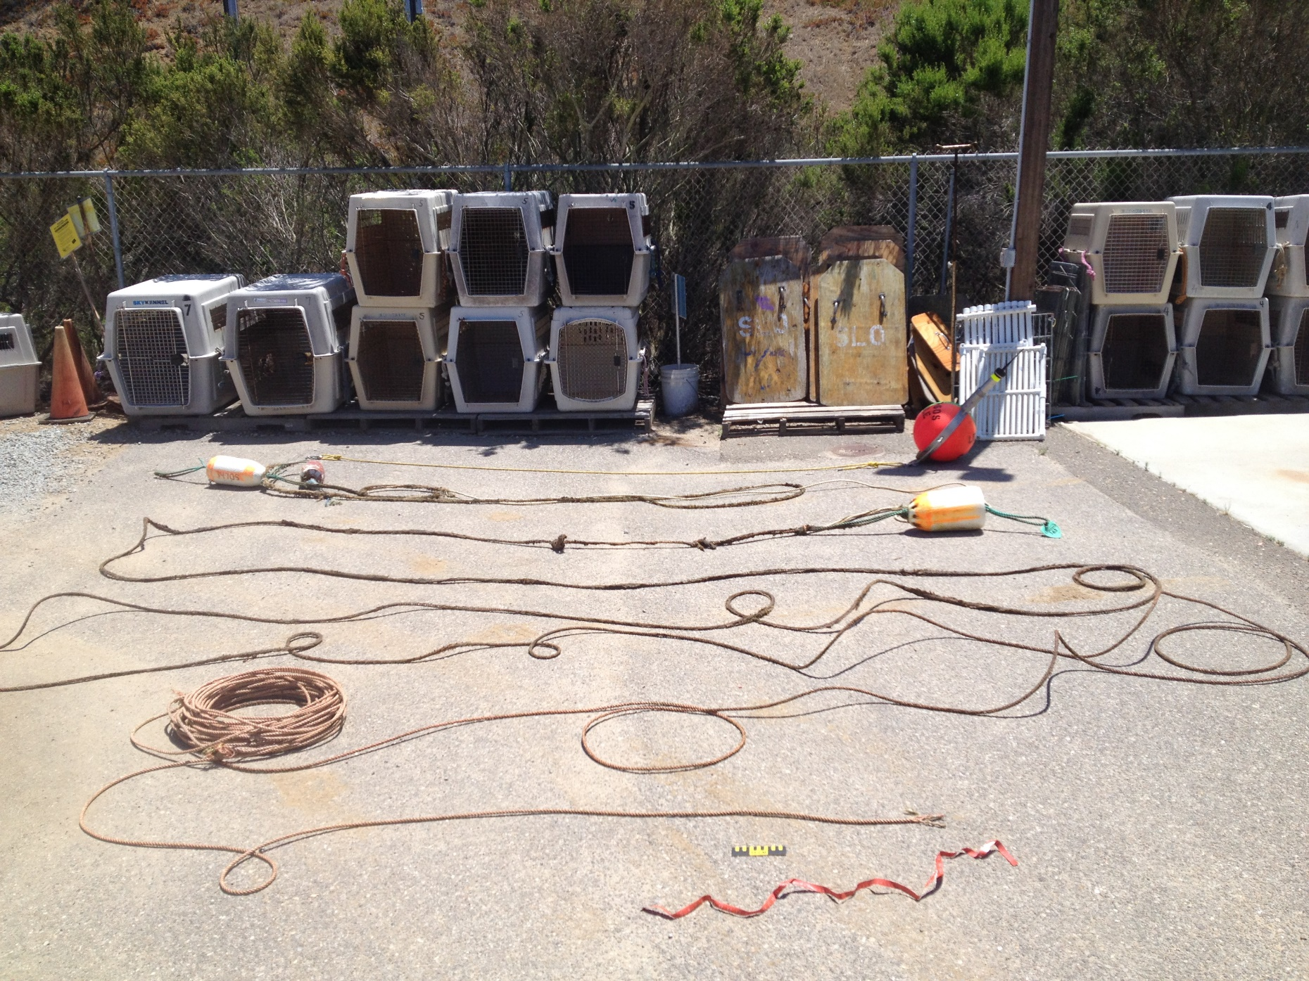
3. 20150625Mn Recovered Gear
NOAA satellite telemetry buoy
NOAA MMHSRP Permit #: 18786

Slide 11
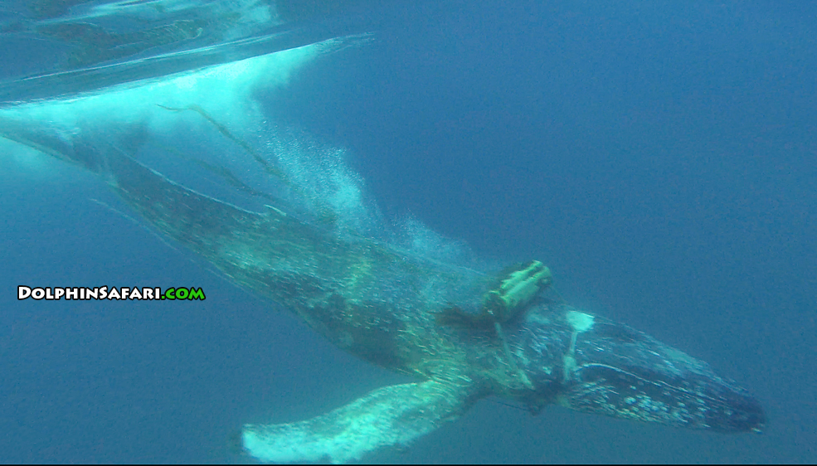
4. 20150926Mn - Humpback
NOAA MMHSRP Permit #: 18786

Slide 12
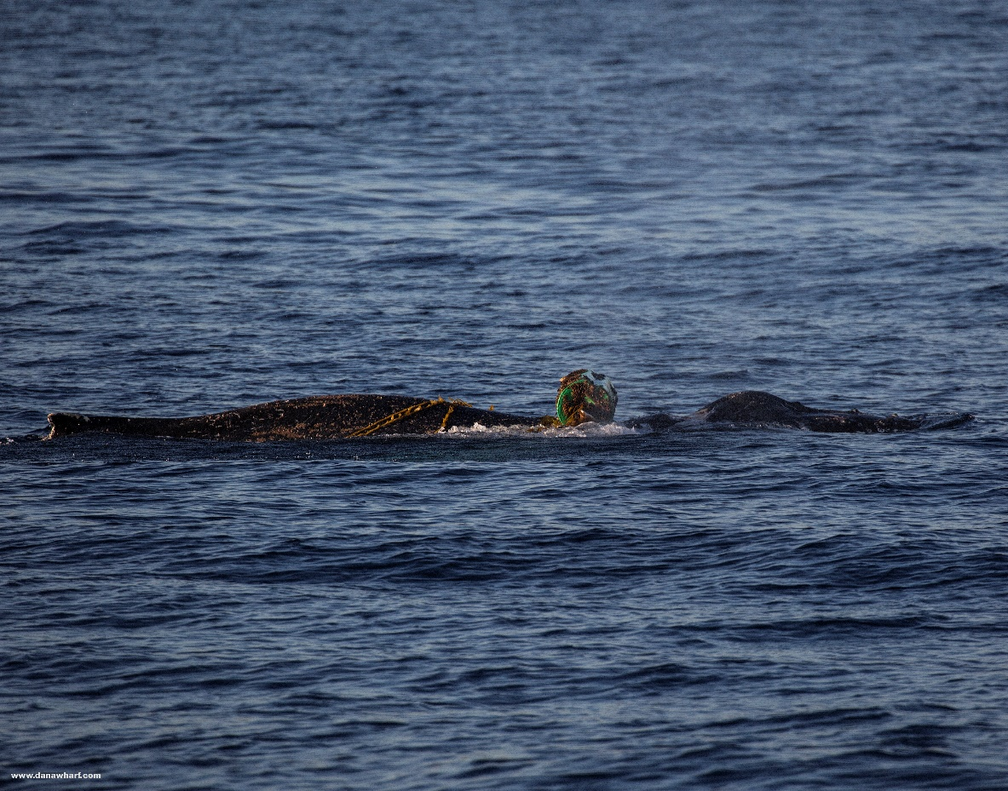
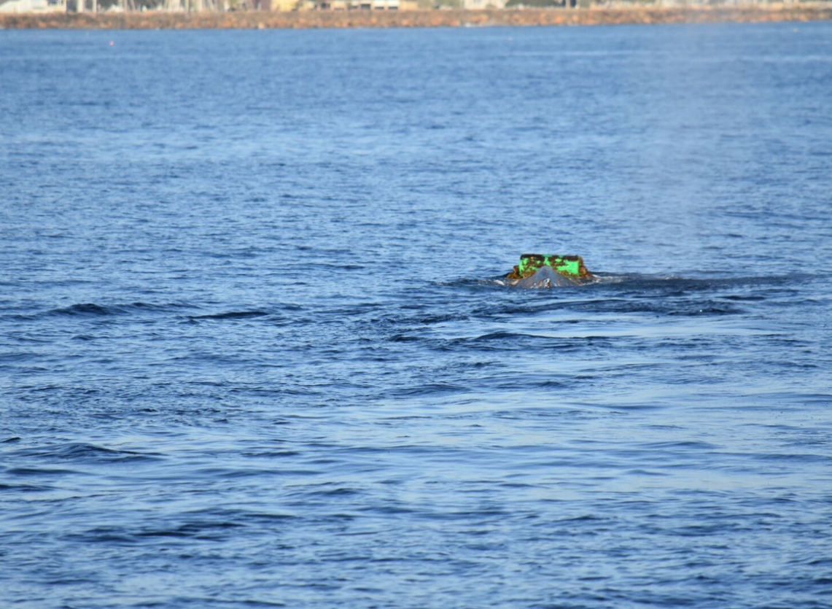
4. 20150926Mn
Originally reported off San Pedro, seen off Redondo Beach, Dana Point, and Point Loma (over 3 months)
Large green cylindrical buoy, ~3ftx2ft, line wrapped around body, buoy directly on top of head, no trailing line
Unknown entanglement type
NOAA MMHSRP Permit #: 18786
NOAA MMHSRP Permit #: 18786

Slide 13
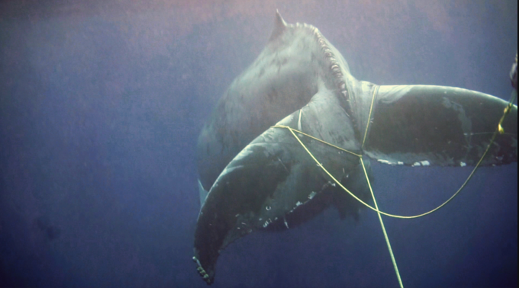
5. 20151025Mn - Humpback
NOAA MMHSRP Permit #: 18786

Slide 14
5. 20151025Mn
Fishery: California commercial lobster
Reported off San Diego 10/25
White bullet buoys, back to back, yellow trailing line, lobster trap attached
From gear owner: 120 FEET NORTH END OF LA JOLLA BETWEEN RESERVES (CRYSTAL RES, OCEAN BEACH RES), DUE TO CLOSURES THEY ARE FISHING MORE IN THE SAND, GEAR USED LEADS, 120 FEET DEPTH, 175 FEET OF LINE, WHEN MOVING FROM SHALLOW TO DEEP LEADS ABOUT 1/2 WAY DOWN, DOUBLE BULLET FLOAT, TRAILERS OCCASSIONALY, LOTS OF CURRENT THIS YEAR, WEIGHT ON TOP TRAP, 3 CONCRETE BRICKS, 7-10 POUNDS OF LINE, 200 FEET OF LINE HAS 3 LEADS.

Slide 15
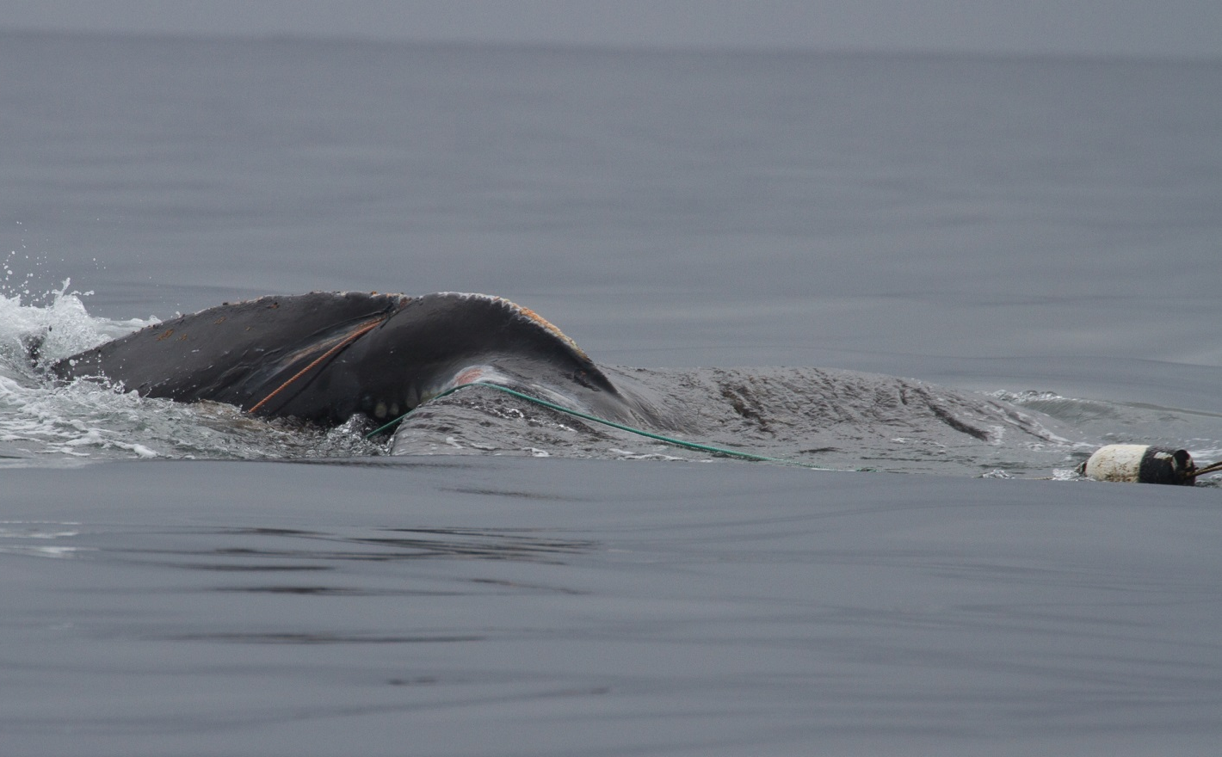
6. 20160416Mn - Humpback
NOAA MMHSRP Permit #: 18786

Slide 16
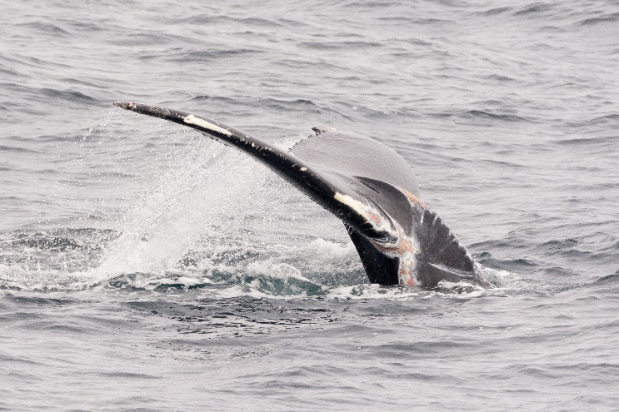
6. 20160416Mn
Fishery: California commercial Dungeness crab
From gear owner: Gear set north of Santa Cruz, southern end of gear set around 37.15 N, not far from 100 fathom curve; three buoy set up- two trailer buoys; in 68 fathoms fishes 85 fathoms orange line, 5 fm to trailer blue line, 3 fm to trailer blue line.
Resighted multiple times between April and June in Monterey area
  Photographed gear free June 4
NOAA MMHSRP Permit #: 18786

Slide 17
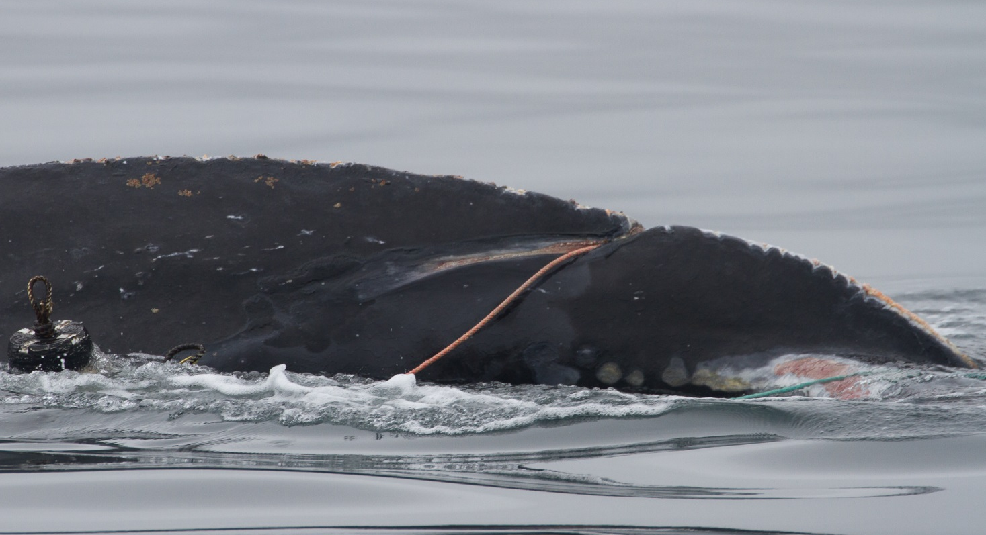
6. 20160416Mn
NOAA MMHSRP Permit #: 18786

Slide 18
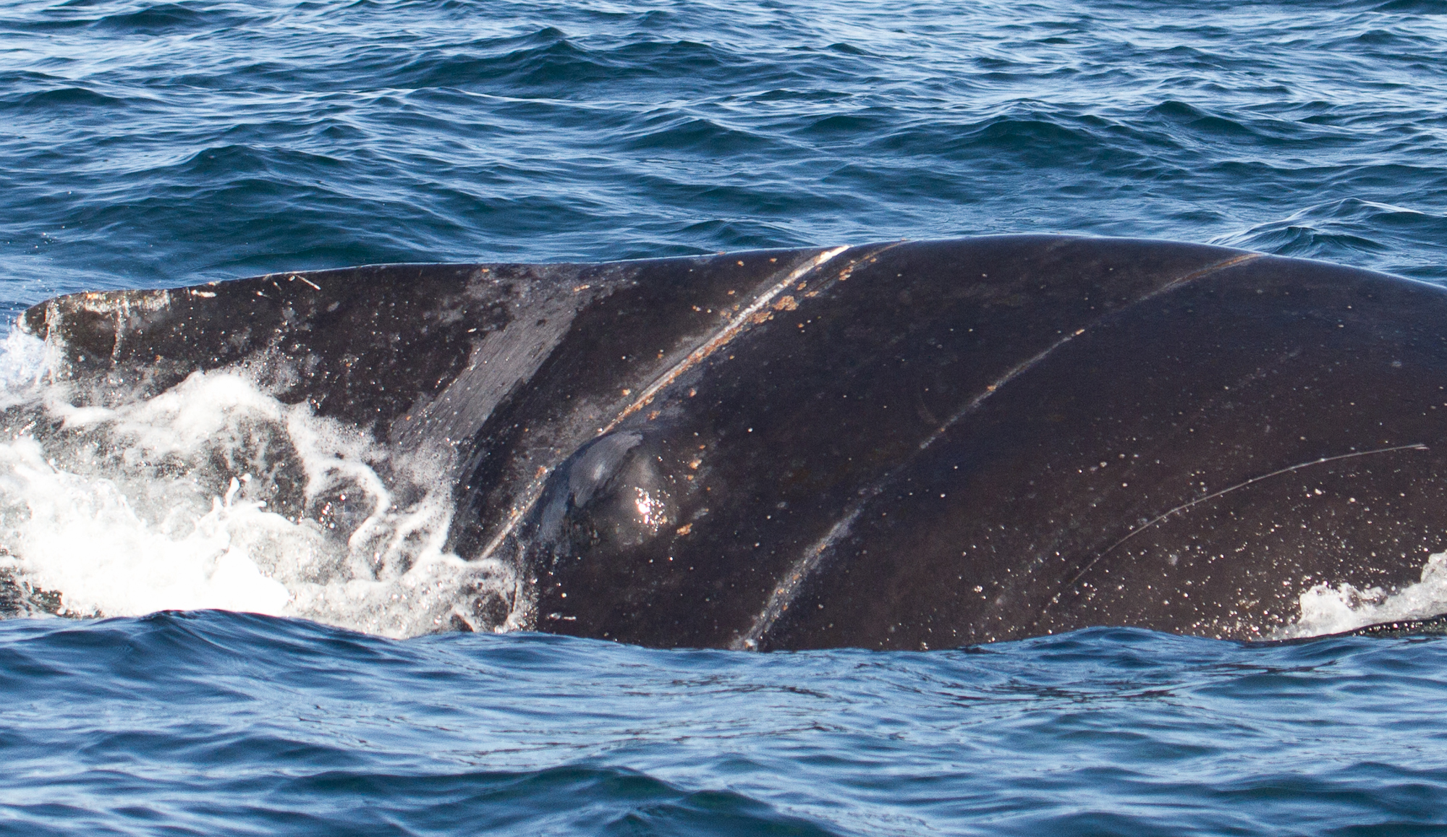
6. 20160416Mn
NOAA MMHSRP Permit #: 18786

Slide 19
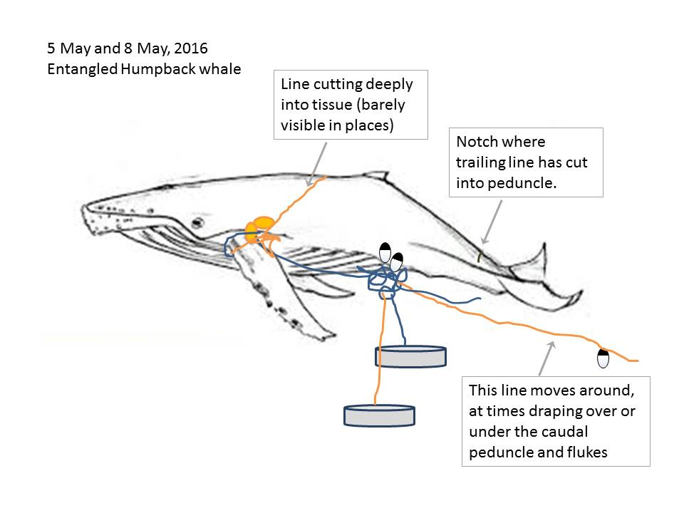
6. 20160416Mn
NOAA MMHSRP Permit #: 18786

Slide 20
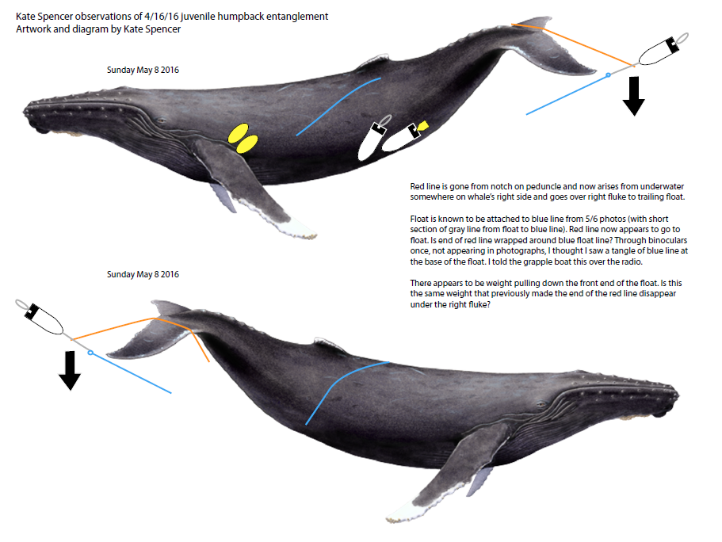
6. 20160416Mn
NOAA MMHSRP Permit #: 18786

Slide 21
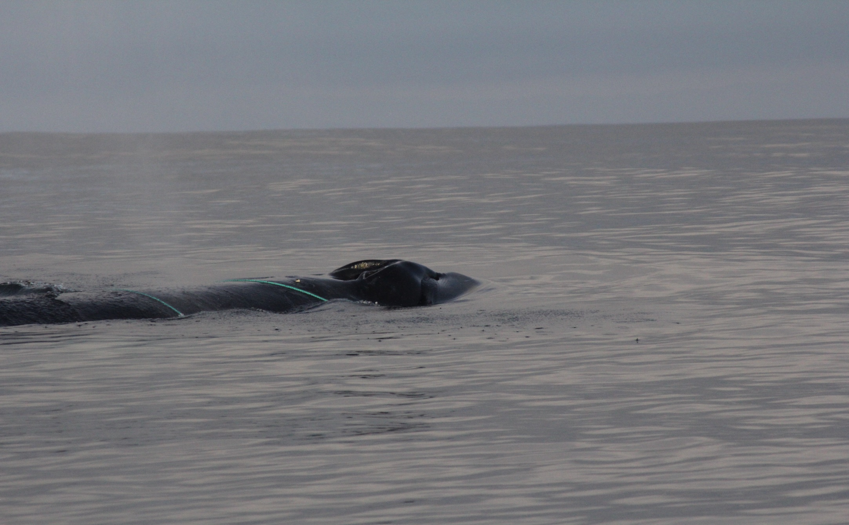
7. 20160420Mn_3 – Humpback
NOAA MMHSRP Permit #: 18786

Slide 22
7. 20160420Mn_3
Fishery: California commercial Dungeness crab
Reported in Monterey on 4/20
Reported as: tandem bullet buoys, 2X wrap around body and both pectoral fins, mouth, tandem orange/pink bullet buoys plus 1 dark orange/red bullet buoy attached to blue/green polyline; trailing ~100 feet of line
Gear owner sent diagram of configuration
Fully disentangled by response team

Slide 23
7. 20160420Mn_3
Drawing from gear owner
NOAA MMHSRP Permit #: 18786

Slide 24
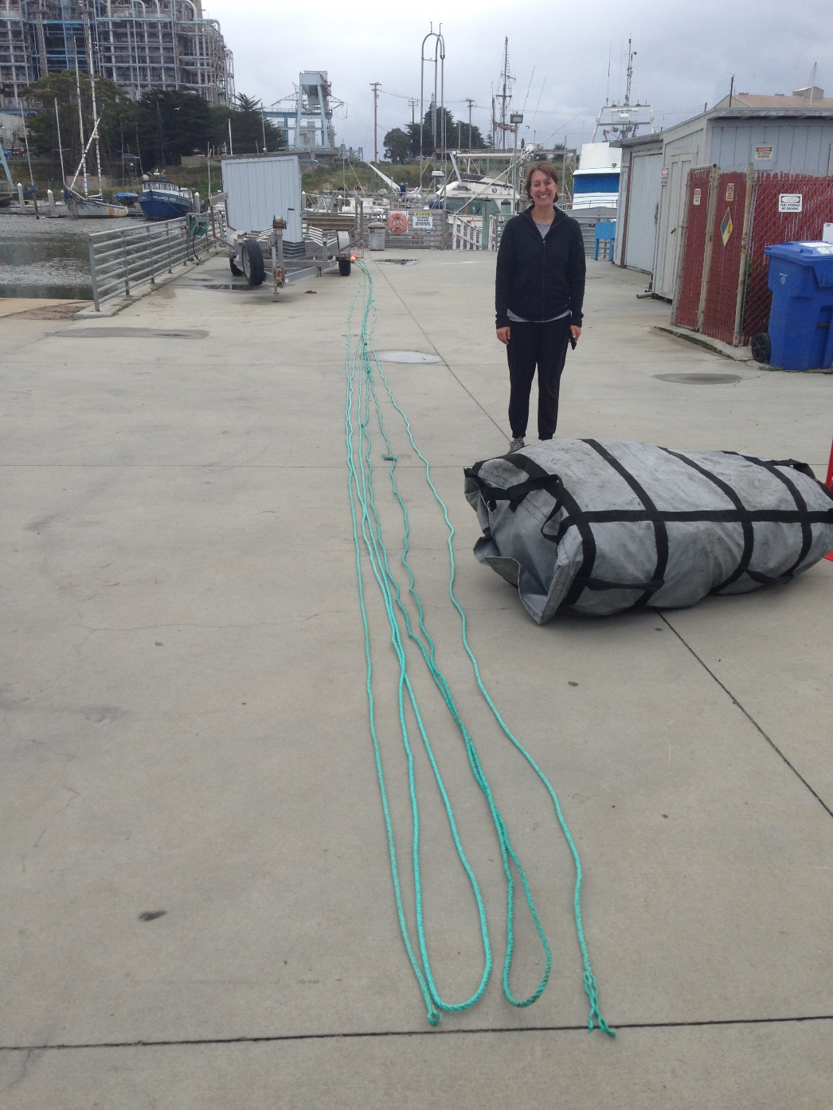
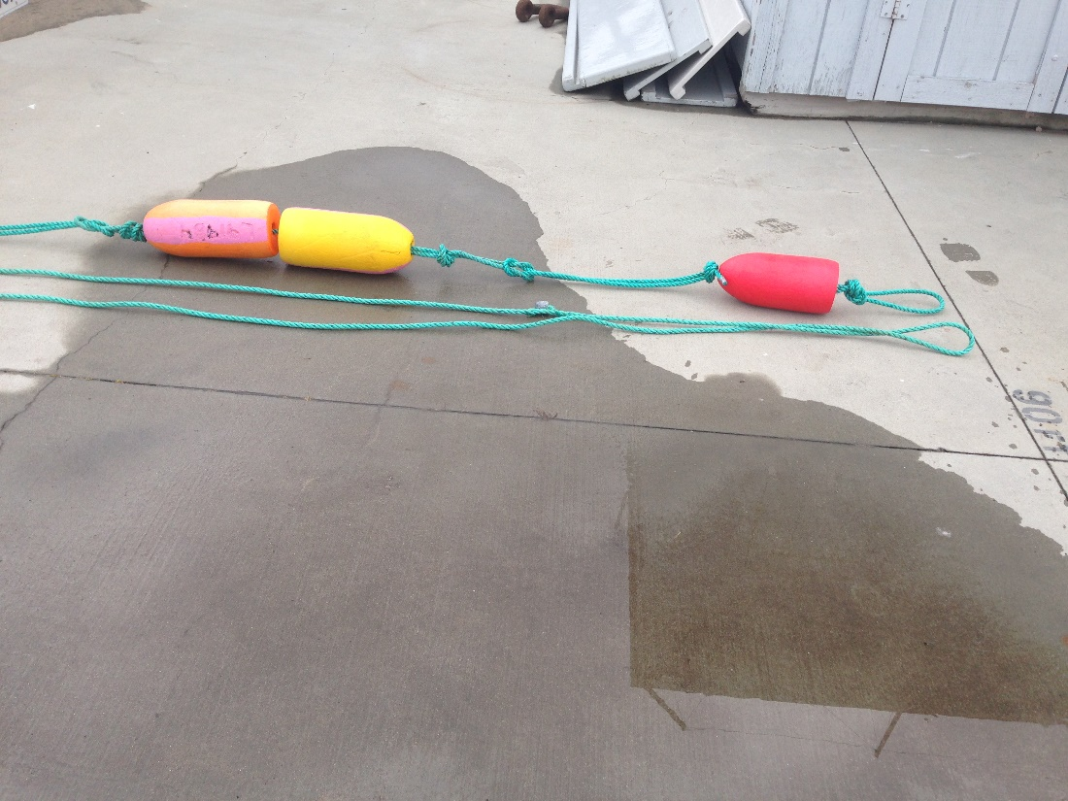
7. 20160420Mn_3 Recovered Gear
NOAA MMHSRP Permit #: 18786
NOAA MMHSRP Permit #: 18786

Slide 25
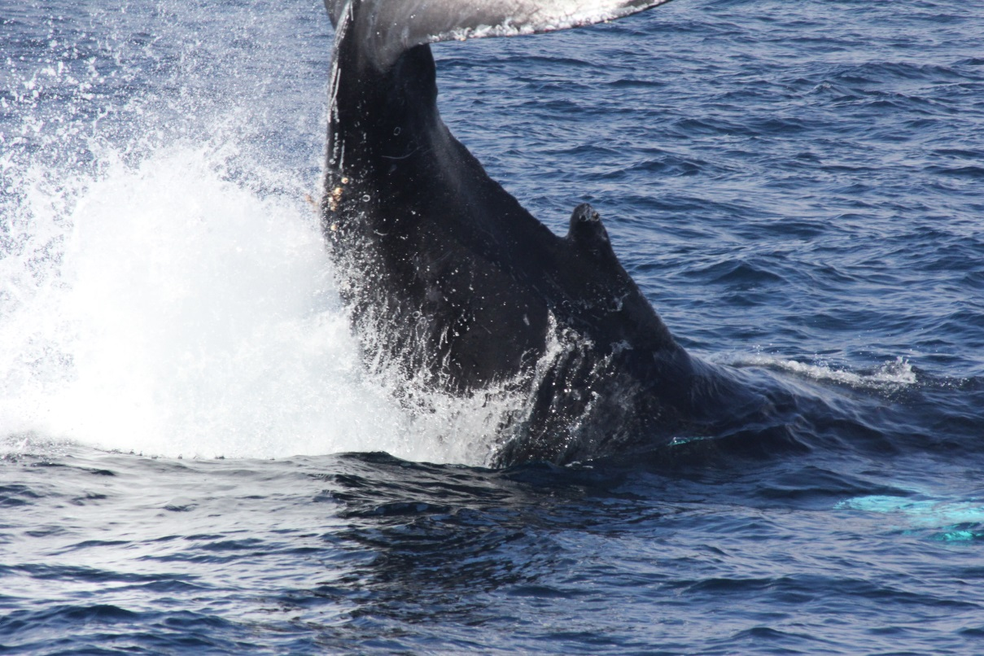
7. 20160420Mn_3 – happy ending
NOAA MMHSRP Permit #: 18786

Slide 26
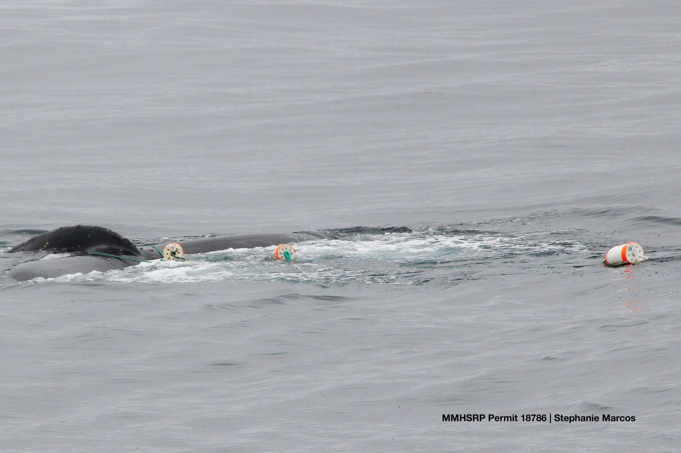
8. 20160510Mn - Humpback

Slide 27
8. 20160510Mn
Fishery: California commercial Dungeness crab
Reported (by fisherman) in Monterey on 5/10/16
Reported as: heavy line from a crab pot system wrapped around both sides of the whale’s flukes, 3 large bullet buoys
Fully disentangled by response team

Slide 28
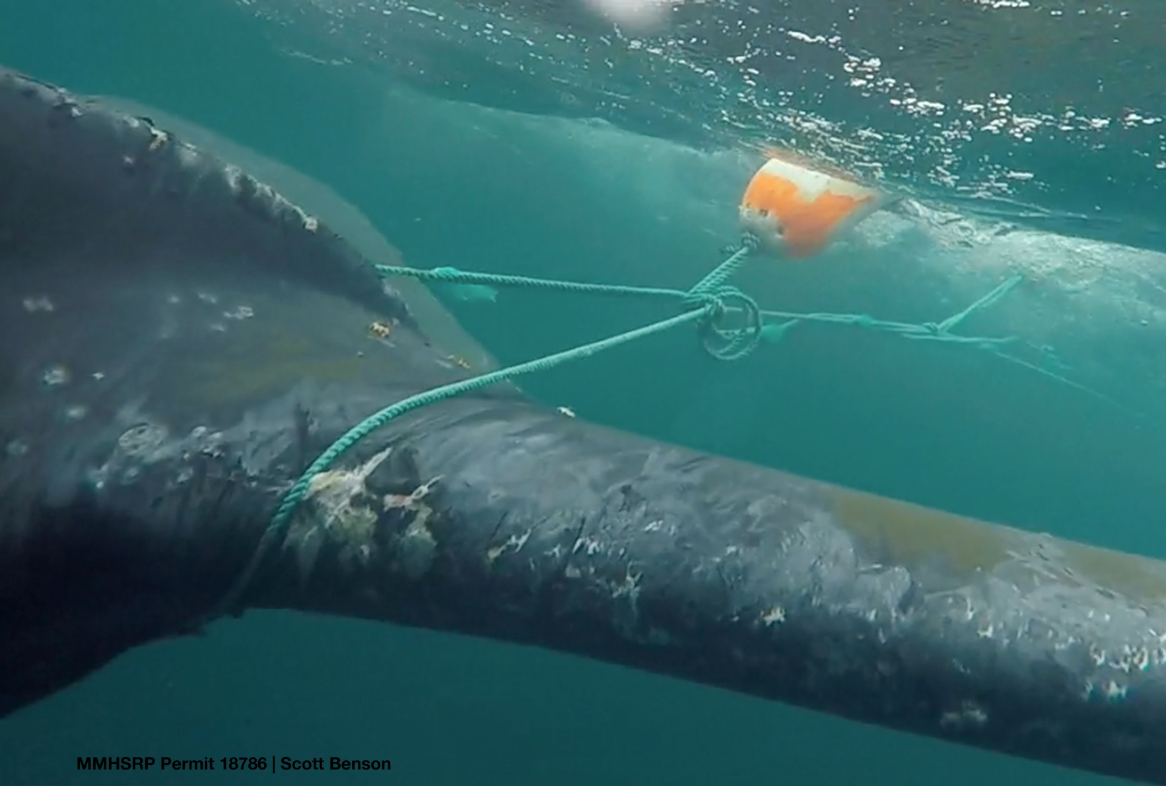
8. 20160510Mn

Slide 29
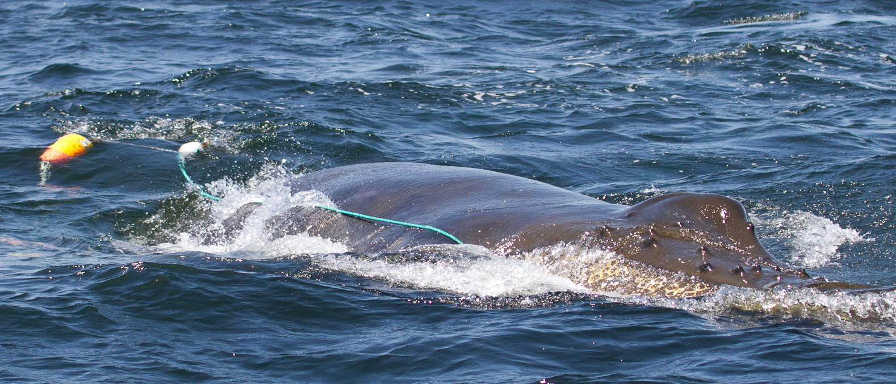
9. 20160522Mn_2 - Humpback
NOAA MMHSRP Permit #: 18786

Slide 30
9. 20160522Mn_2
Fishery: reported as “crab pot”
Reported in Monterey on 5/22/16
Reported as: Blue line comes out of the right corner of mouth, down right side of boy, 4 buoys total; resighting comment: 100 feet of blue line, 3/4 to 1 inch line, trailing behind whale, believed to originate from mouth; 4 buoys, 3 orange, 1 white

Slide 31
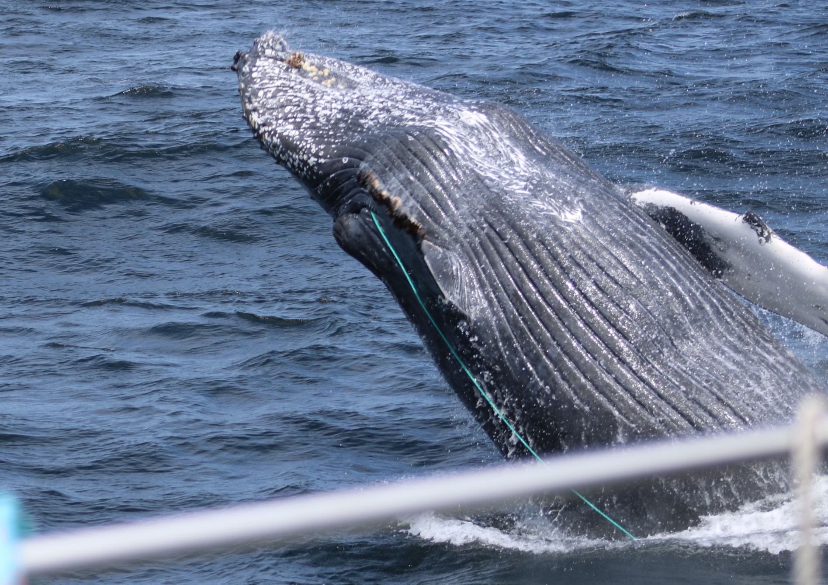
9. 20160522Mn_2
NOAA MMHSRP Permit #: 18786

Slide 32
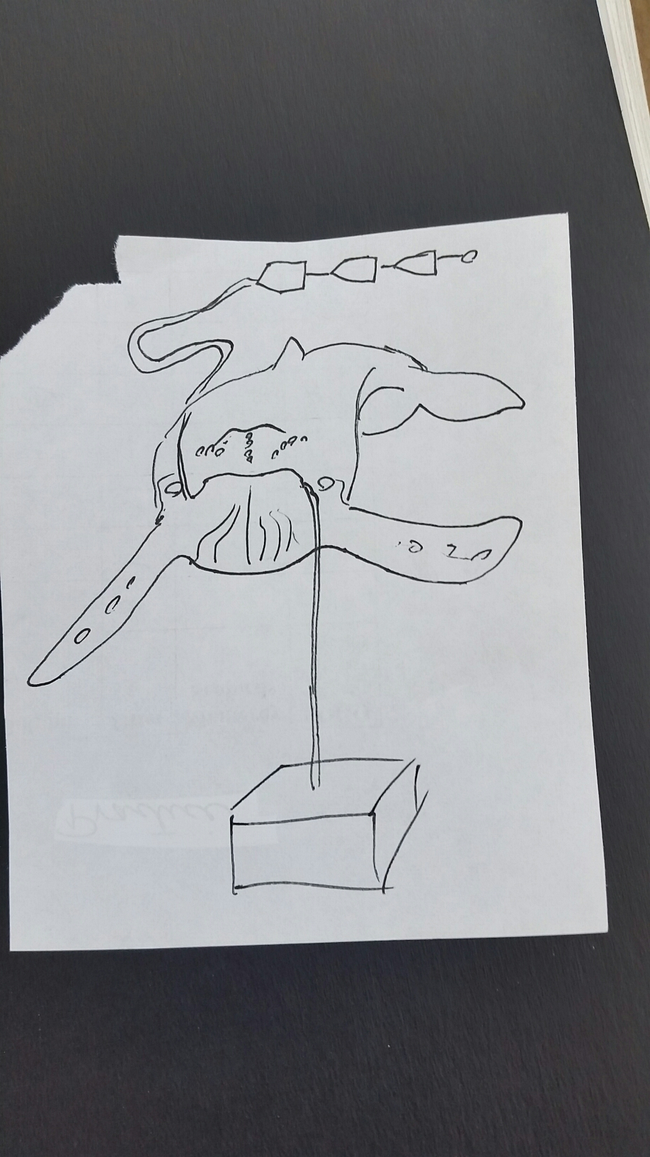
9. 20160522Mn_2
NOAA MMHSRP Permit #: 18786

Slide 33
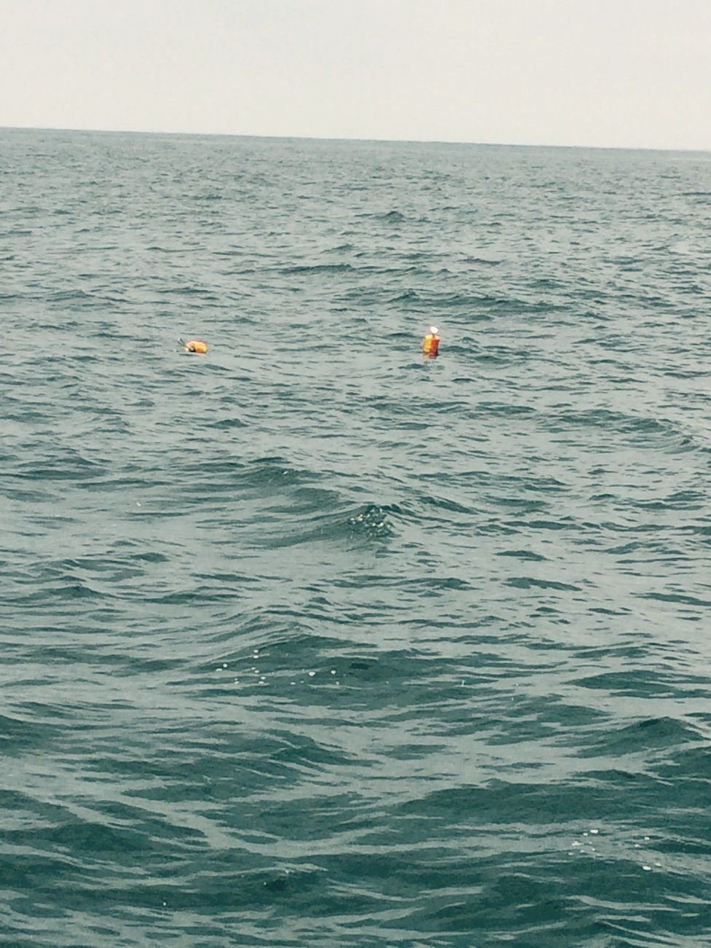
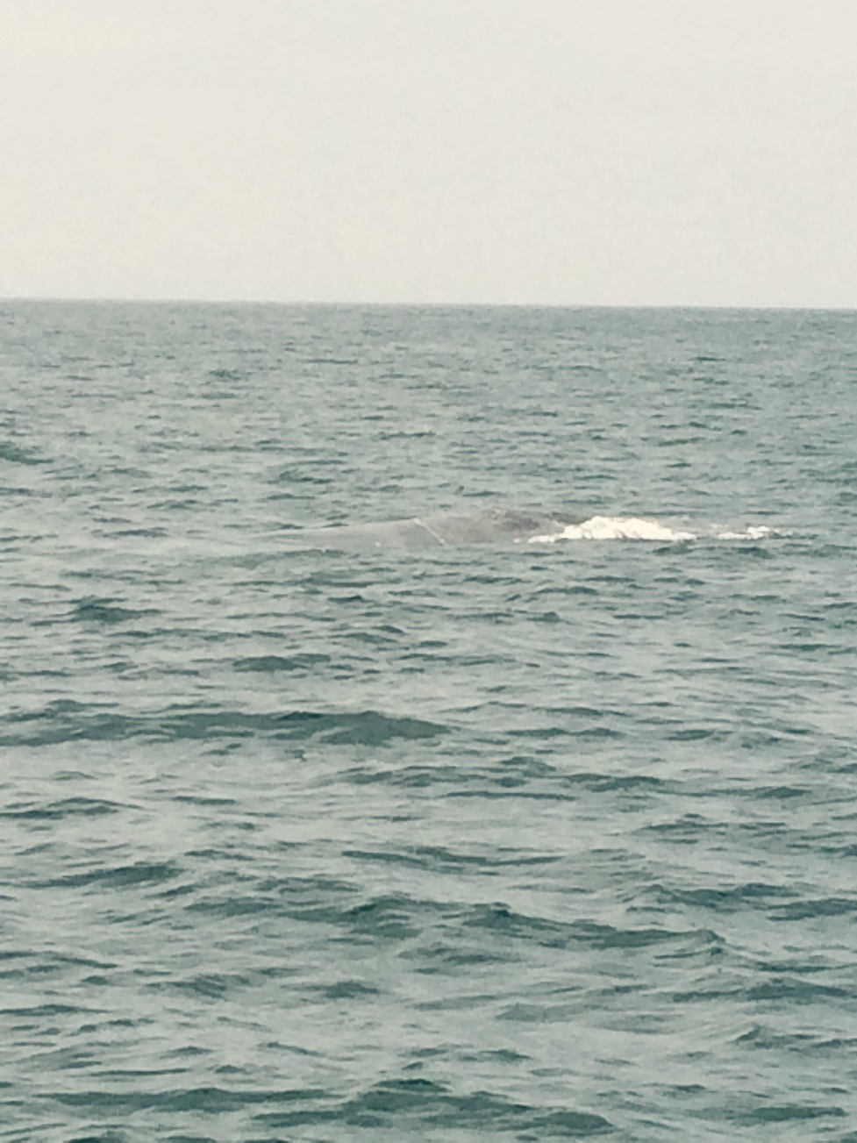
10. 20160626Bm - Blue
NOAA MMHSRP Permit #: 18786
NOAA MMHSRP Permit #: 18786

Slide 34
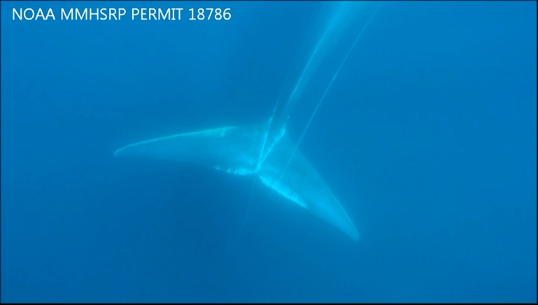
10. 20160626Bm
From entanglement response video

Slide 35
10. 20160626Bm
Blue whale
Fishery: California commercial Dungeness crab
Reported off San Diego 6/26/16, re-sighted off Dana Point 6/27/16
From responders: the entanglement comes from either the mouth or the pecs...I suspect the mouth as the line runs down both sides of the body and goes over the fluke then once it goes over the edge of the fluke it drops straight down to what we believe is the pot still on the line and then the line comes back up to the surface approx. 150 feet behind the whale with no gear at the surface except the buoys as lines come up from pot to buoys.

Slide 36
10. 20160626Bm
-Notes from gear owner:
Doesn’t know which string of traps it might have come from as he had several scattered from Point Buchon to Point Pismo
Gear ranging from 40 fathoms out to 68 fathoms. He knows he lost a handful of traps from his gear, but again scattered throughout his gear. He didn’t lose any traps until about the time salmon season started, and figures it was probably sometime in June if he had to guess. He fished all the way until the close of the crab season.
He mostly uses 25 fathom shots of line, although he does have some 15 fathom shots as well. His approach would be to put out 2 shots out (50 fathoms) if he was fishing 40 fathoms, and 3 shots out (75 fathoms) if he was fishing 68 fathoms. Generally, he maintains relatively tight gear (5-15 fathoms of scope) to minimize the hauling time necessary.
He uses 3/8ths blue steel line. He uses 1 fathom line back to one trailer buoy. He uses 2 leads on each 25 fathom shot, basically each spaced 1/3 the length of the line. He uses a spliced loop to attach the leads.

